Slide 1
II 클라우드 플랫폼 서비스 Aws
신라대학교 노철우 교수

Slide 2
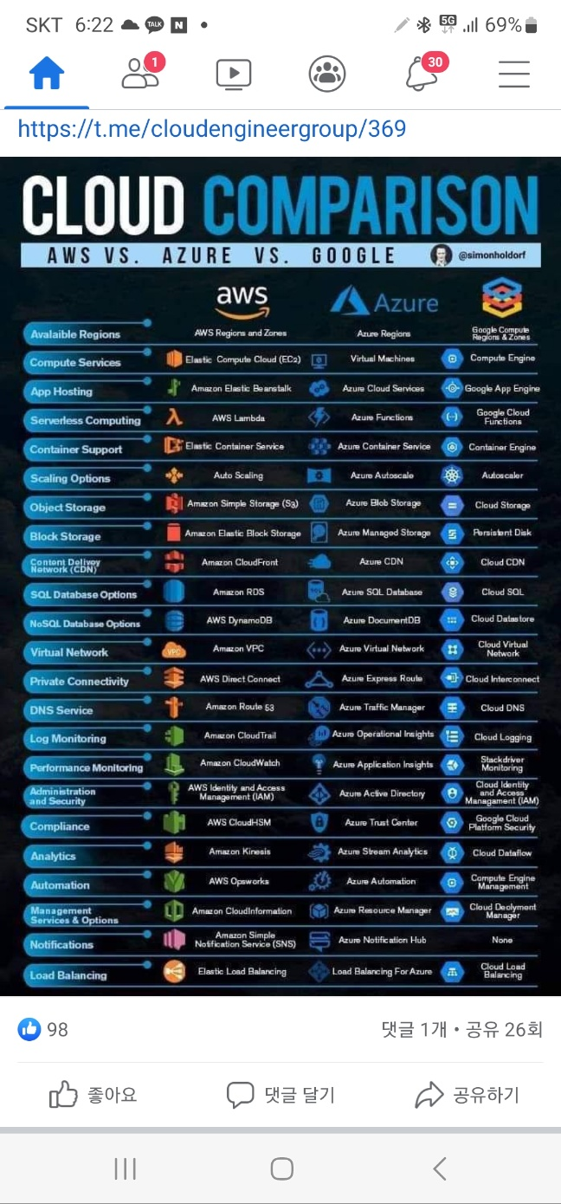

Slide 3




























AWS 서버리스 포트폴리오
애플리케이션 빌딩 블록 – 컴퓨팅 및 저장소 서비스
Athena
Amazon
S3
AWS
Lambda
AWS
Fargate
애플리케이션 통합
Amazon
DynamoDB
Amazon Aurora Serverless
Amazon
Kinesis
Amazon
SNS
Amazon
API Gateway
AWS
Step Functions
개발자 도구
Amazon
MQ
Amazon
SQS
AWS
AppSync
AWS
CloudFormation
AWS
Cloud9
AWS
CodePipeline
AWS
Config
AWS
CloudTrail
Amazon
CloudWatch
AWS
X-Ray
AWS Serverless Application Repository
보안 및 운영 관리
AWS
IAM
AWS
SSO
Amazon
GuardDuty
Amazon
Inspector
Amazon
VPC
AWS
WAF
AWS
Shield
Amazon
Cognito
© 2019, Amazon Web Services, Inc. or its affiliates. All rights reserved.

Slide 4

























Amazon EC2
Amazon
SES
Amazon ECR
Amazon
RDS
Amazon ECS
Amazon
Aurora
AWS Elastic
Beanstalk
Amazon
DynamoDB
AWS
Lambda
Amazon
ElastiCache
Auto Scaling
Amazon
SQS
IAM
AWS KMS Amazon
S3
AWS Step Functions
Amazon
SNS
Amazon
CloudWatch
AWS
CloudFormation
AWS
CloudTrail
Amazon API
Gateway
Elastic Load
Balancing
Amazon
CloudFront
Amazon
Kinesis
Amazon
Route 53

Slide 5
Course material
git clone https://github.com/cwro777/awscloudcomputing24.git

Slide 6
local git에서 file upload
>echo " this is lecture cloud plaform" > README.md
>"README.md"
git add ./* //모든 폴더 및 파일
git commit -m "upload"
git remote add origin https://github.com/misook-git/lect_cloudplatform.git
git remote remove origin
git push -u origin main

Slide 7
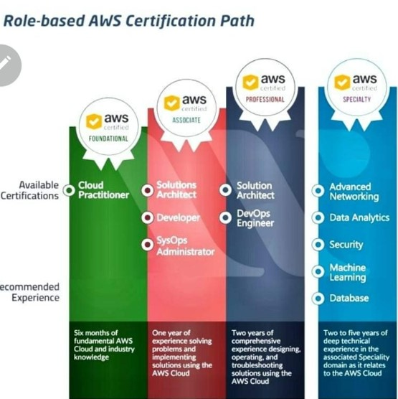

Slide 8
Classic Ports to know
• 22 = SSH (Secure Shell) - log into a Linux instance
• 21 = FTP (File Transfer Protocol) – upload files into a file share
• 22 = SFTP (Secure File Transfer Protocol) – upload files using SSH
• 80 = HTTP – access unsecured websites
• 443 = HTTPS – access secured websites
• 3389 = RDP (Remote Desktop Protocol) – log into a Windows instance
© Stephane Maarek

Slide 9

목차
AWS Cloud Platform
1
AWS EC2
2
AWS S3 & IAM
3
AWS RDS
4
AWS Lambda
5
mini project

Slide 10
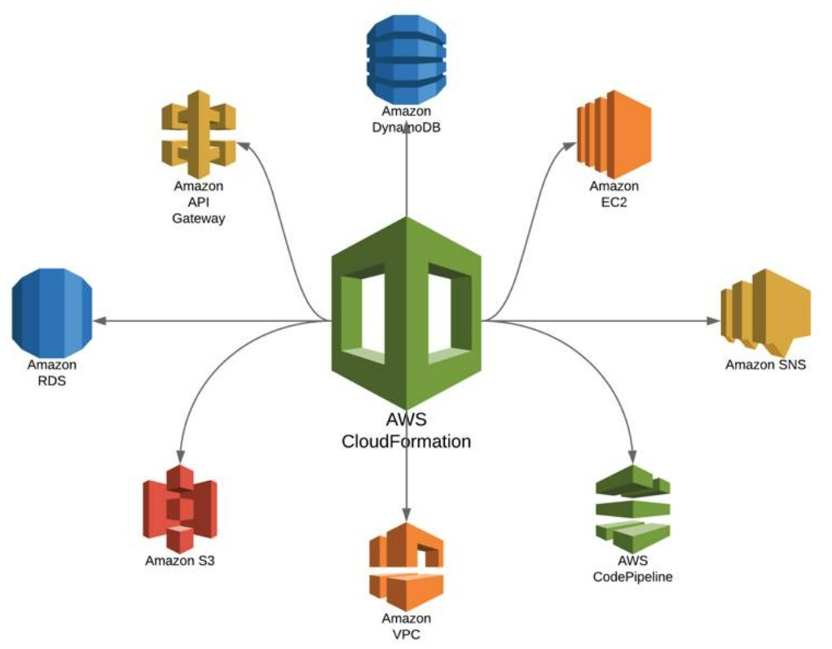
AWS Architect

Slide 11

1
AWS EC2
Lectures
AWS 계정관리
EC2
EC2 instance
Linux web server
Hands-on
Aws platform
EC2, Putty

Slide 12
AWS free tier
https://aws.amazon.com/free
https://aws.amazon.com/ko/free/?all-free-tier.sort-by=item.additionalFields.SortRank&all-free-tier.sort-order=asc&awsf.Free%20Tier%20Types=*all&awsf.Free%20Tier%20Categories=*all

Slide 13
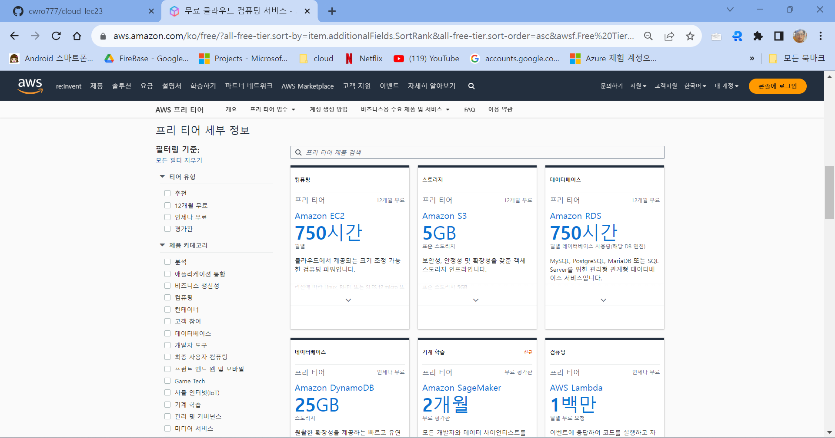

Slide 14


AWS EC2
EC2 instance 생성
EC2 접근 - Keypair
EC2 웹서버 – 리눅스
EC2 웹서버 – 윈도우
SILLA UNIVERSITY

Slide 15
AWS account
아마존 계정 생성
http://aws.amazon.com

Slide 16
AWS account
계정 활성화
결제 수단 추가하기
휴대폰 번호 인증하기
AWS 지원 플랜(Support Plan) (무료) 선택하기
활성화 후 확인 이매일 수신

Slide 17
AWS Support팀 문의
우측 상단에 지원 > 지원 센터 클릭
https://aws.amazon.com/premiumsupport/knowledge-center/create-and-activate-aws-account/

Slide 18
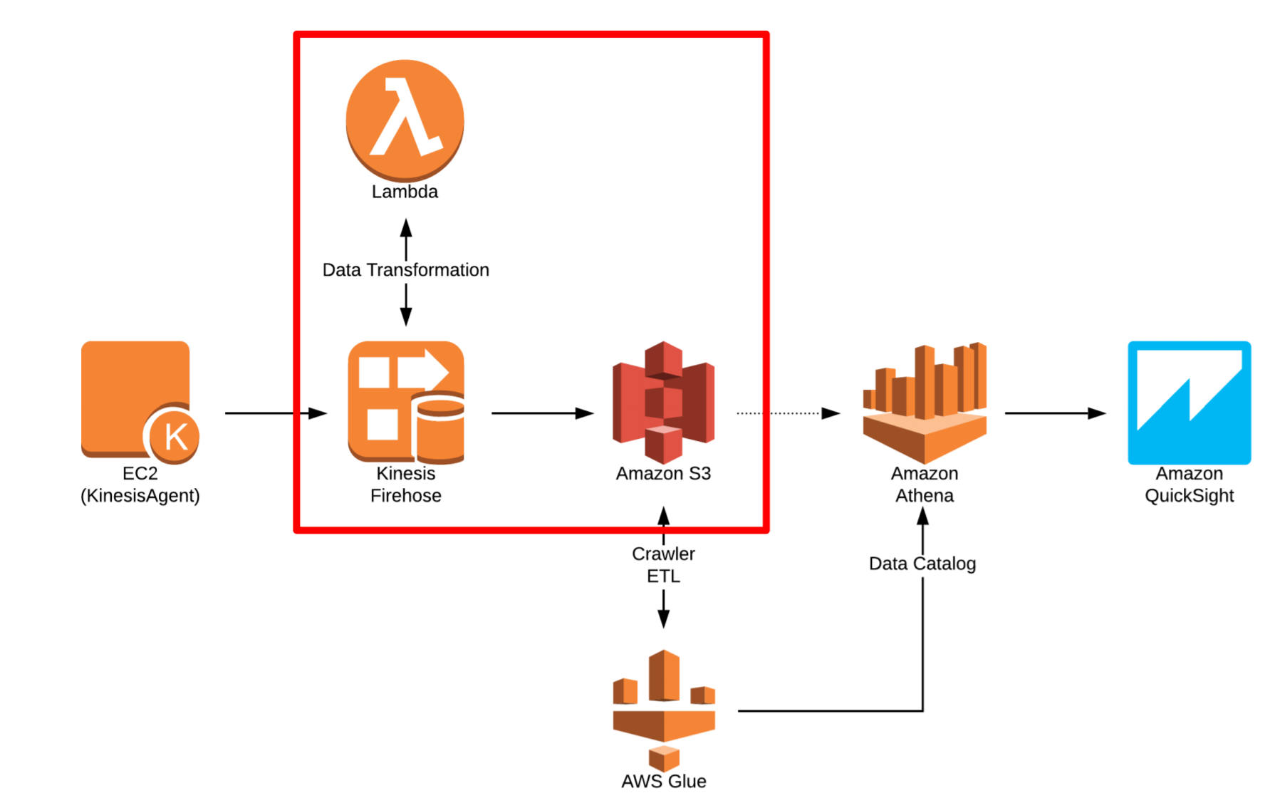
AWS Architect

Slide 19

Amazon EC2
Amazon Elastic Compute Cloud (EC2) offers virtual computing environments , known as
instances you can launch and manage with a few clicks of a mouse or a few lines of code.
Most server operating systems are supported.
Create, save, and reuse your own server images as Amazon Machine Images (AMIs). Add more instances when you need them; terminate when you do not
Launch one instance at a time or launch a whole fleet.
CPU, memory, storage, networking, graphics, and general purpose instance types are available.
Amazon EC2 instances in Amazon VPC now offer native support for the IPv6 protocol.
Use security groups to control traffic to and from instances.

Slide 20
Amazon Machine Image (AMI)
Amazon Machine Image (AMI) defines the initial software that will be on an instance when it is launched serving as the basic unit of deployment for services delivered using Amazon EC2 and defines every aspect of the software state at instance launch including:
The Operating System (OS) and its configuration The initial state of any patches
Application or system software
All AMIs are based on X86 Oss, either Linux or Windows.

Slide 21




Broad Set of Compute Instance Types
GPU- or FPGA-
Enabled (Accelerated Computing)
General Purpose
Compute Optimized
Storage and I/O Optimized
Memory Optimized
Burstable Performance
X1e
P3
M5
C5
H1
T2
X1
P2
M4
C4
I3
R4
G3
D2
F1

Slide 22



Amazon EC2 Pricing
Spot Instances
Reserved Instances
Dedicated Hosts
On-Demand
Per-second billing (Amazon Linux and Ubuntu only)
Per-hour billing (All other OSs)
Per-hour billing

Slide 23
Linix command
ls, ls –l, ls –a
cd, mkdir
pwd
su, whoami, su passwd root
chmod 777

Slide 24
EC2 생성
EC2 만들기
EC2 설정 : AMI, 타입, 세부설정, 보안그룹, 키발급
EC2 실행 : launch
EC2 접속
Linux : SSH
PuttyGen으로 PPK 파일 만들기 (keypair)
Putty : SSH 접속
Window : RDP
원격데스크톱파일다운로드 (RDP)
키페어--암호 복사 --> RDP Administrator, pw:

Slide 25
putty
Download putty : www.putty.org
https://www.chiark.greenend.org.uk/~sgtatham/putty/latest.html
MSI(‘Windows Installer) – puttygen
Alternative binary files – putty.exe (.76 vs 0.78 private ppk )
SSH 연결
puttygen : .pem 다운로드 → ppk 파일 생성
putty
Data = ec2-user, ubuntu
Auth : ppk 파일
Window - Appearance – point 글자크기 확장

Slide 26
EC2 - webserver
Linux webserver (데비안 Ubuntu)
$sudo apt-get update 대신
sudo passwd root //root pw 설정
su
apt-get update
apt-get install apache2
cd /var/www/html
sublime/FTP
cd ~ubuntu/index.html .

Slide 27
IDE, text editor
FileZilla
https://filezilla-project.org/download.php
Sublime
Linux : nano editor, vi editor
AWS : Cloud9
Azure: VSC

Slide 28
FileZilla
사이트 관리자 → 새 사이트
프로토콜 → SFTP
호스트 , 포트 → 22
로그온 유형 → 키파일

Slide 29
Linux webserver (AMI)
cat /ect/*release* //linux version
sudo passwd root //method 1: root user
su
yum update -y
yum install -y httpd
systemctl start httpd
systemctl enable httpd
cd /var/www/html
echo "<h1>Hello webserver from $(hostname -f)</h1>" >index.html

Slide 30
. Elastic IP & instance scale up
Instance state : run-> stop-> start
Network&Security → Elastic IP → Allocate Ip → Associate add
AMI image create
Instance → actions → image and templates → create image
AMI → 우측마우스 →launch // scale up on new image
AMI → launch instance from AMI
associate add using Elastic IP
disassociate add
release IP
delete (deregister) AMI, delete snapshot

Slide 31
Linux webserver (AMI)
cat /ect/*release* //linux version
sudo yum update –y //method 2 use sudo
sudo yum install -y httpd
sudo systemctl start httpd
sudo systemctl enable httpd
// cd /var/www/html
echo "<h1>Hello webserver from $(hostname -f)</h1>" >index.html
cp index.html /var/www/html/.

Slide 32
Linux webserver (Redhat, CentOS)
$yum install httpd
$service httpd start

Slide 33
MAC 운영체제 내의 SSH를 이용한 EC2연결방법
1. EC2 인스턴스 생성시 연결 키를 ppk가 아닌 pem으로 받는다
2. pem파일의 권한을 r— — —으로 변경한다 (sudo chmod 400 pem파일)
3. 터미널에서 아래의 명령어를 이용하여 연결한다.
ssh -i pem경로 ec2-user@퍼블릭 IPv4주소

Slide 34
EC2 - webserver
Window webserver
manage -add roles - server roles -web server(iis) - install
Local server IE Enhanced seurity configuration → off
c:\inetpub\wwwroot\
Index.html

Slide 35
Python3 in EC2
Download FileZilla Client for Windows (64bit)
filezilla-project.org › download
In Ubuntu 18.04,
pip intstall 대신 python-pip t설치하고 pip3 install 명령 사용
python 3 설치되 있음
sudo apt-get update
sudo apt-get install python3-pip python3-venv
pip3 install bs4
#pip upgrade
sudo –H pip3 install –-upgrade pip

Slide 36
Python3 in EC2
install python3 on CentOS
yum update -y
yum install -y python3
python3

Slide 37
AWS Billing Alarm/Alert
- In the Billing & Cost Management dashboard, select "Preferences" from the left-hand menu.
- Scroll down to the "Billing Alerts" section and click on "Receive Billing Alerts."
- Choose the type of alerts you want to receive (e.g., Free Tier Usage, Total Spending, etc.).
- Define your billing thresholds. You can set different thresholds for various services or regions.
- Specify the notification method (e.g., email, SNS topic, etc.) and recipients for the alerts.
4. **Save Your Alert Configuration**: After configuring your billing alerts, make sure to save your changes.
5. **Review and Confirm**: Double-check your alert settings to ensure they match your requirements. Once you're satisfied, confirm your selections.
6. **Test Your Alerts (Optional)**: You might want to perform a test by intentionally exceeding your billing threshold to ensure that the alerts are working as expected.
7. **Monitor and Adjust**: Regularly monitor your AWS usage and billing to ensure that your alerts are appropriately configured. Adjust your alert thresholds
Setting up billing alerts helps you stay informed about your AWS spending and can prevent unexpected expenses. It's a proactive step toward managing your AWS costs effectively.

Slide 38
2
AWS S3 & IAM
AWS 계정관리
Lectures
AWS 과금관리
Elastic IP & Autoscaling
S3
CloudFront
IAM
Hands-on
Aws platform
S3

Slide 39
AWS S3
S3 bucket 생성
File upload
Static web site hosting
SILLA UNIVERSITY

Slide 40
S3
S3 Simple Storage Service
클라우드 객체 스토리지,
콘텐츠 저장 및 전송, 빅데이터 분석, backup
bucket 생성하고 객체를 버킷에 저장
naming: no upper case, no underscore
AWS Management Console을 통해 Amazon S3 리소스에 액세스하고 관리
Amazon S3 vs Amazon S3 Glacier

Slide 41
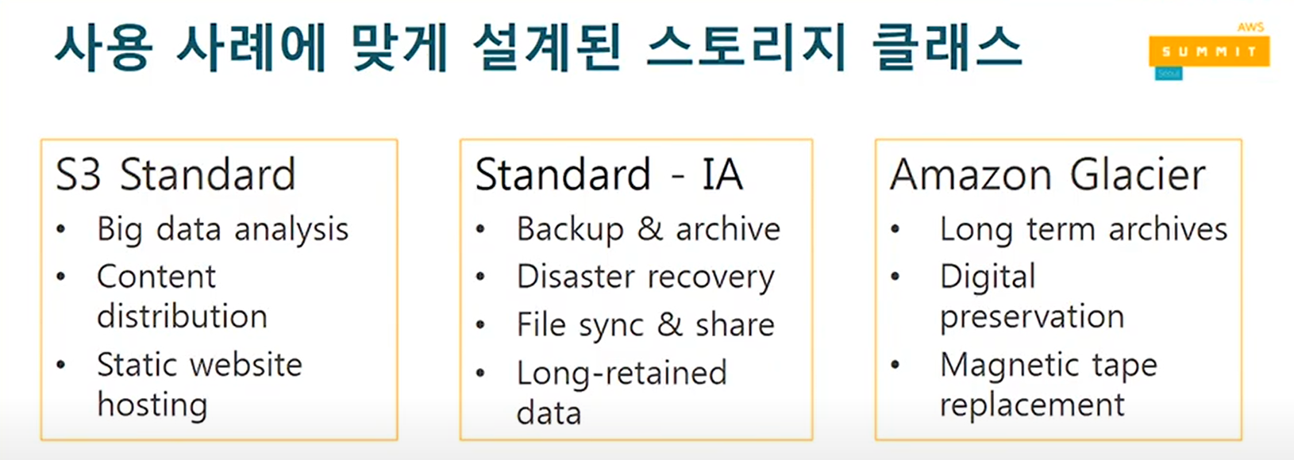
AWS Storage
AWS SUMMIT, https://www.youtube.com/watch?v=3gSzIwh7RyM&t=1822s

Slide 42
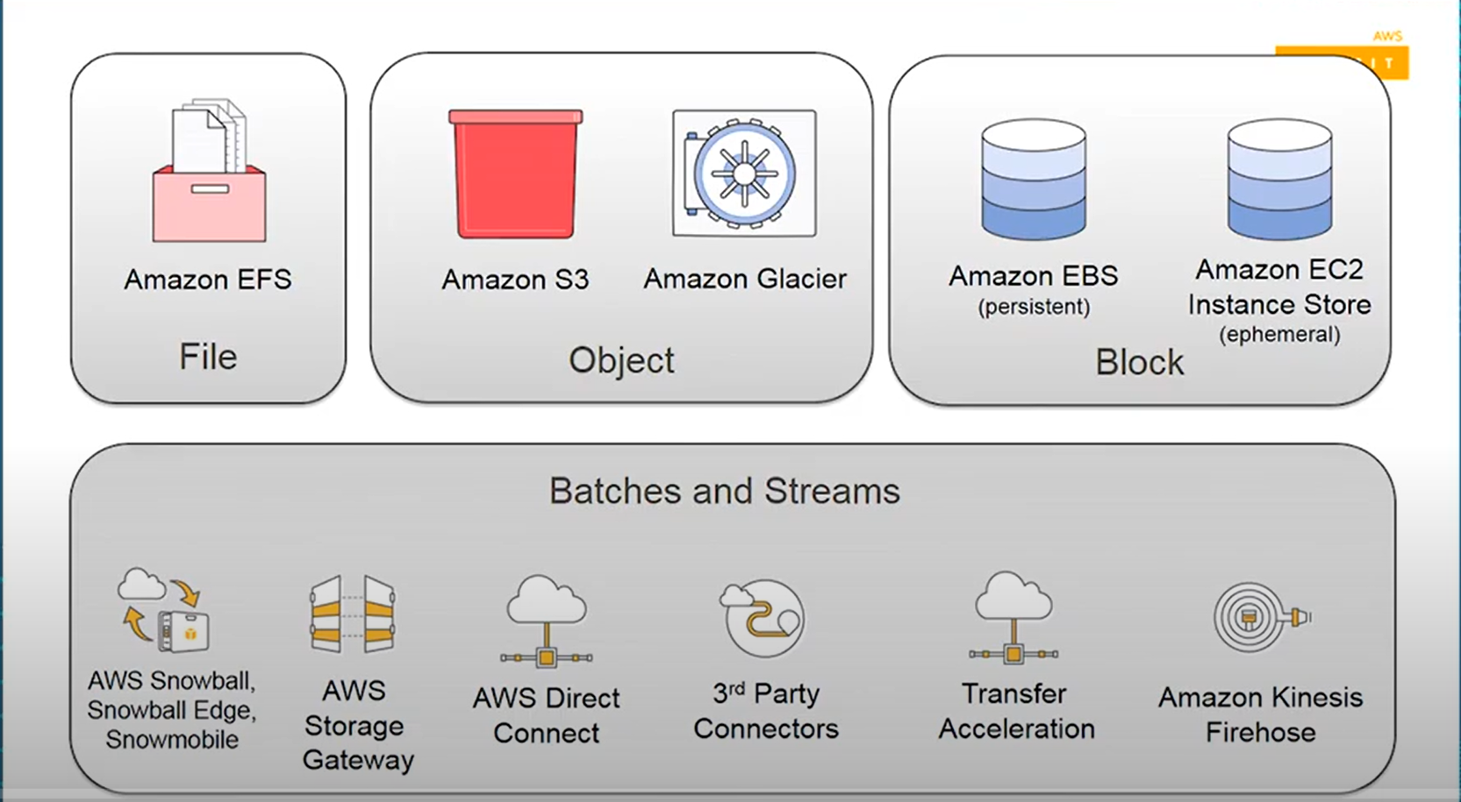
AWS Storage
AWS SUMMIT, https://www.youtube.com/watch?v=3gSzIwh7RyM&t=1822s

Slide 43
S3 bucket
File upload
Static web hosting

Slide 44
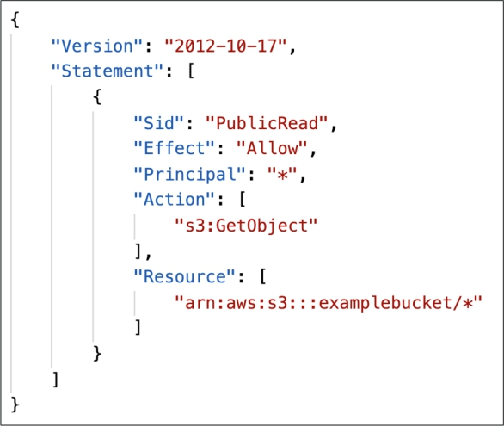
S3 Bucket Policies
JSON based policies
Resources: buckets and objects
Effect: Allow / Deny
Actions: Set of API to Allow or Deny

Slide 45
S3 Access
Bucket
Permission
Block public access
Bucket policy
Edit ➔ policy generator

Slide 46
S3 Access
bucket
create
open
Object Action
Share with a presigned URL

Slide 47
S3 Permission/Security
User-based
IAM policies
Resource based
Bucket policy
ACL (Access Control List) : object, Bucket
Bucket →Permissions

Slide 48
S3 Access - Policy generator
step1: select policy type: S3Bucket policy
step2: Add Statements
Effect: Allow
principal: * //anyone
AWS service: Amazon S3
Actions: Get objects
ARN: arn:aws:s3:::cwbucket3/* //copy S3 bucket ARN (cwbucket2/properties) here
add statement
generate policy

Slide 49
S3 static website
S3 properties
Static website →
host a static website
Index.html
Upload index.html

Slide 50
S3 Event Notification
S3 object create, remove, restore, replication
S3 events

Slide 51
S3 Event Notification
Lambda
Event
S3
SQS
SNS

Slide 52
S3 Event Notification : SQS
s3 bucket -> Properties -> create event notification
create SQS
Unknown error ==>SQS 대기열이 S3 bucket 메세지를 수락하지 않기 때문
update SQS Access policy
SQS -> Access/Queue policy -> edit
Policy generator
- action: sendmessage
-ARN: SQS Access policy -> Resource: arn *****
SQS
send and receive message --> poll for messages : check-

Slide 53
S3 Replication
S3 object replication
Properties – Bucket Versioning – Enabled
Origin bucket :
Management – Replication rules - create Replication rule ➔ apply

Slide 54
AWS CloudFront
Cache server + CDN (content delivery Network)
SILLA UNIVERSITY

Slide 55
CloudFront
CDN (Content delivery Network)
Content is cached at the edge
216 edge locations
DDoS protection
Worldwide, integration with shield, web application firewall
https://aws.amazon.com/cloudfront/features/?nc=sn&loc=2

Slide 56

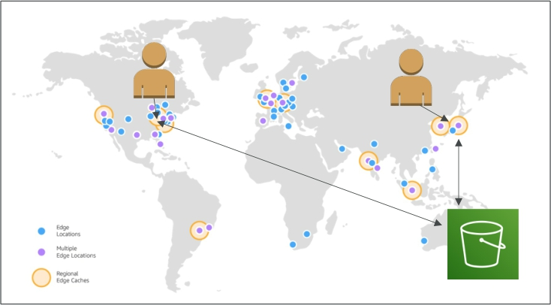
Amazon CloudFront
• Content Delivery Network (CDN)
• Improves read performance, content
is cached at the edge
• Improves users experience
• 216 Point of Presence globally (edge
locations)
• DDoS protection (because worldwide), integration with Shield, AWS Web Application Firewall
NOT FOR DISTRIBUTION © Stephane Maarek www.datacumulus.com
Source: https://aws.amazon.com/cloudfront/features/?nc=sn&loc=2
© Stephane Maarek

Slide 57
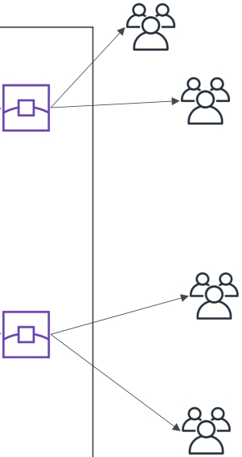
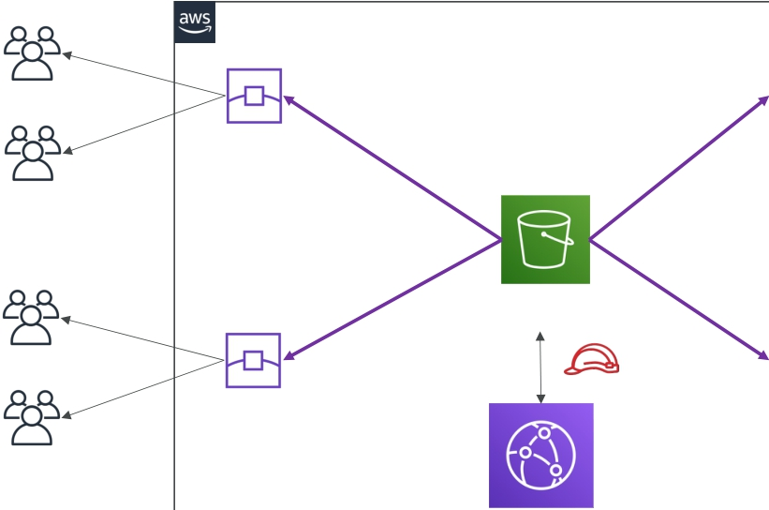
CloudFront – S3 as an Origin
AWS Cloud
Public www Private AWS
Edge
Los Angeles
Private AWS
Private AWS
Private AWS
Origin (S3 bucket)
Edge
Mumbai
NOT FOR DISTRIBUTION © Stephane Maarek www.datacumulus.com
Public www OAC
Edge
São Paulo
Edge
Melbourne
Origin Access Control + S3 bucket policy
© Stephane Maarek

Slide 58
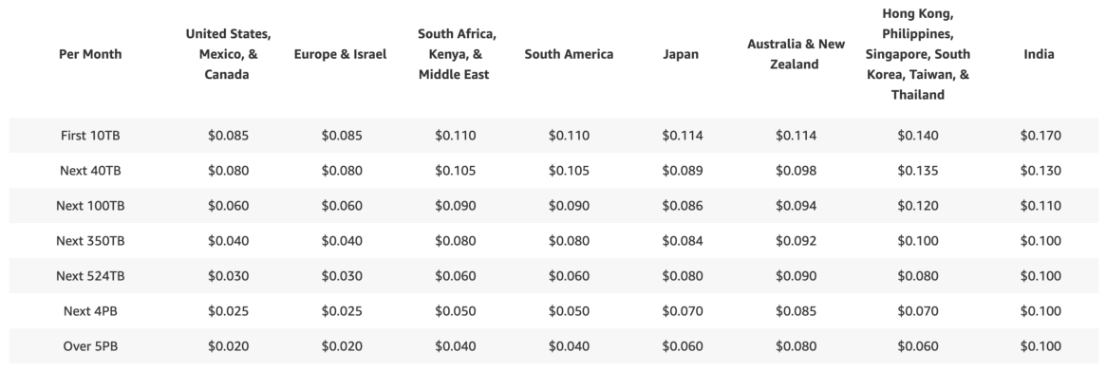
CloudFront - Pricing
• CloudFront Edge locations are all around the world
• The cost of data out per edge location varies
lower
NOT FOR DISTRIBUTION © Stephane Maarek www.datacumulus.com
higher
© Stephane Maarek

Slide 59
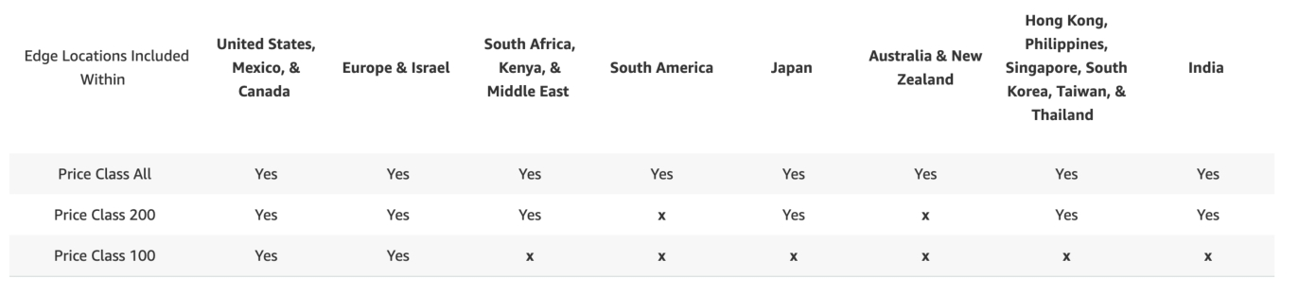
CloudFront – Price Classes
• You can reduce the number of edge locations for cost reduction
• Three price classes:
1. Price Class All: all regions – best performance
2. Price Class 200: most regions, but excludes the most expensive regions
3. Price Class 100: only the least expensive regions
© Stephane Maarek
NOT FOR DISTRIBUTION © Stephane Maarek www.datacumulus.com

Slide 60
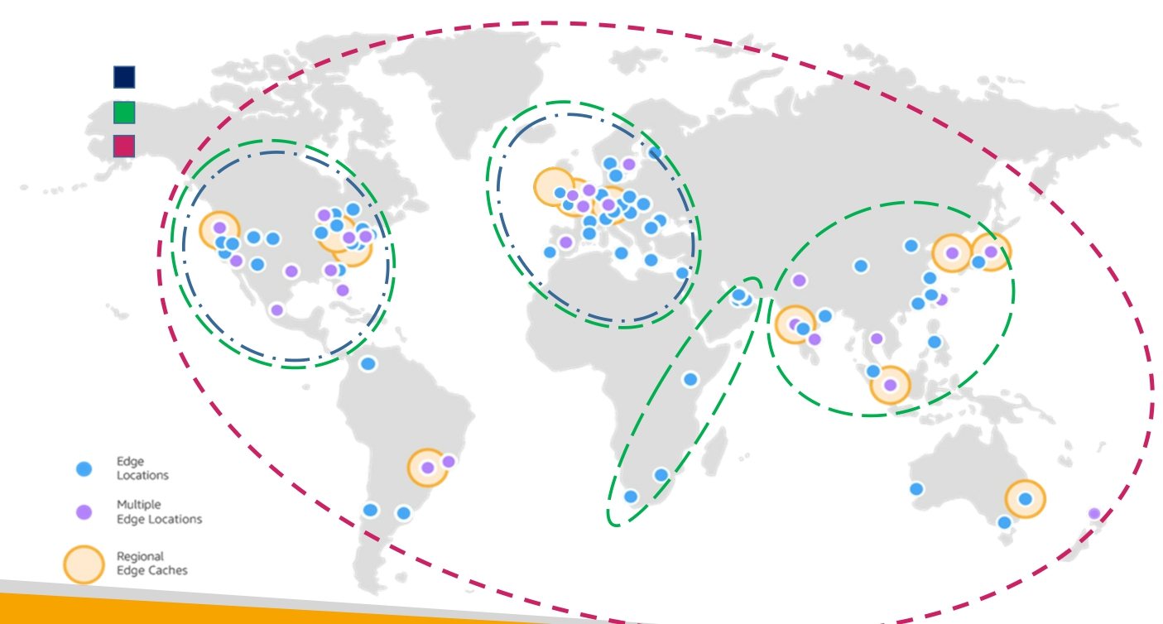
CloudFront - Price Class
Prices Class 100 Prices Class 200 Prices Class All
© Stephane Maarek
NOT FOR DISTRIBUTION © Stephane Maarek www.datacumulus.com

Slide 61
CloudFront
origin
distribution
cloudFront
EC2 or S3
distribution
-web server
origin
-web server

Slide 62
CloudFront
OAC (Origin access control)
create control setting //click
created new distribution
Do not enable WAF
default root object -> index.html
S3 bucket policy needs to be updated (1st method)
copy policy on cloud front
permission →Bucket policy→ edit – paste policy
Distribution (2nd method)
origin -- Edit --scroll down --copy policy ==> S3 bucket permission

Slide 63
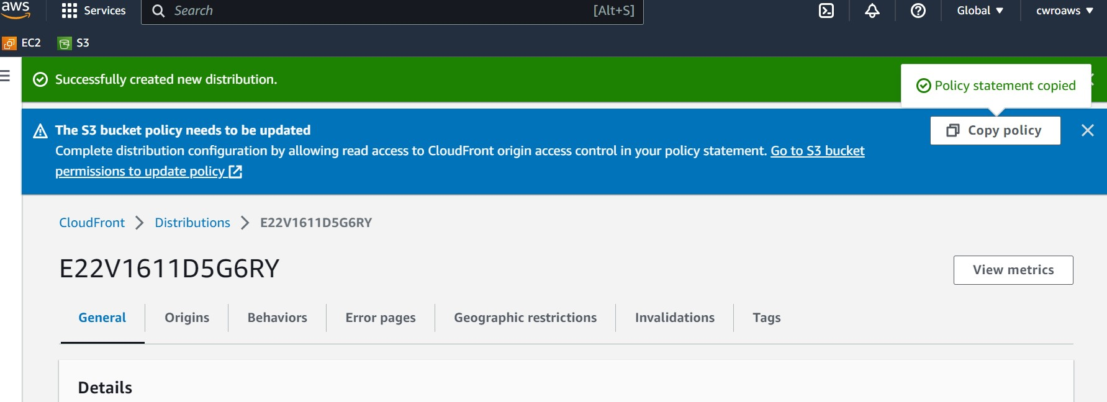

Slide 64
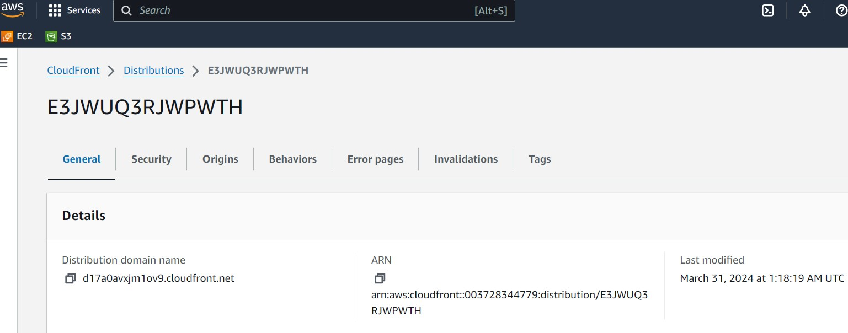

Slide 65
Cloud Front
delete distribution
disable
Delete
delete origin access

Slide 66

AWS SNS
Simple notification Service
SILLA UNIVERSITY

Slide 67
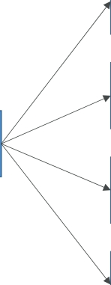
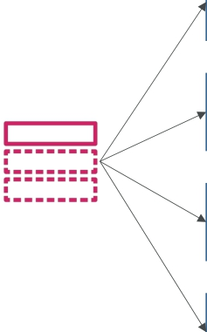
Amazon SNS
• What if you want to send one message to many receivers?
Direct
integration
Buying
Service
Email
notification
Fraud
Service
Shipping
Service
SQS Queue
Pub / Sub
Buying
Service
Email
notification
Fraud
Service
Shipping
Service
SQS Queue
NOT FOR DISTRIBUTION © Stephane Maarek www.datacumulus.com
SNS Topic
© Stephane Maarek

Slide 68




Amazon SNS
• The “event producer” only sends message to one SNS topic
• As many “event receivers” (subscriptions) as we want to listen to the SNS topic notifications
• Each subscriber to the topic will get all the messages (note: new feature to filter messages)
• Up to 12,500,000 subscriptions per topic
• 100,000 topics limit
Subscribers
NOT FOR DISTRIBUTION © Stephane Maarek www.datacumulus.com
publish
SQS
Lambda
Kinesis Data
Firehose
SNS
Emails
SMS &
Mobile Notifications
HTTP(S)
Endpoints
© Stephane Maarek

Slide 69










SNS integrates with a lot of AWS services
• Many AWS services can send data directly to SNS for notifications
…
CloudWatch Alarms AWS Budgets Lambda
NOT FOR DISTRIBUTION © Stephane Maarek www.datacumulus.com
… publish
Auto Scaling Group
(Notifications)
S3 Bucket
(Events)
DynamoDB
… SNS
CloudFormation
(State Changes)
AWS DMS
(New Replic)
RDS Events
© Stephane Maarek

Slide 70
Amazon SNS – How to publish
• Topic Publish (using the SDK)
• Create a topic
• Create a subscription (or many)
• Publish to the topic
• Direct Publish (for mobile apps SDK)
• Create a platform application
• Create a platform endpoint
• Publish to the platform endpoint
• Works with Google GCM, Apple APNS, Amazon ADM…
© Stephane Maarek
NOT FOR DISTRIBUTION © Stephane Maarek www.datacumulus.com

Slide 71
Amazon SNS
• create topic
• Create a subscription (or many)
Protocol → Email , lambda, SQS,
Endpoint : cwro777@gmail.com, After your subscription is created, you must confirm it
pending confirmation: status : pending → Confirmed
create subscription
SNS → lambda
https://www.youtube.com/watch?v=yPbRwmZIG68
© Stephane Maarek
NOT FOR DISTRIBUTION © Stephane Maarek www.datacumulus.com

Slide 72
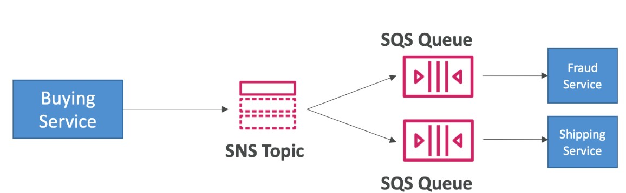
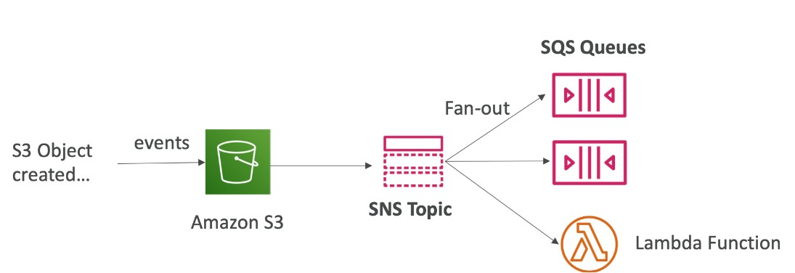
Amazon SNS Fan out
•
© Stephane Maarek
NOT FOR DISTRIBUTION © Stephane Maarek www.datacumulus.com

Slide 73
Amazon SNS
• SNS → lambda
https://www.youtube.com/watch?v=yPbRwmZIG68
© Stephane Maarek
NOT FOR DISTRIBUTION © Stephane Maarek www.datacumulus.com

Slide 74
3
AWS RDS
AWS 계정관리
Lectures
AWS RDS
webapp in portal
Hands-on
RDS
web data generator

Slide 75
AWS RDS : Relational Database Service
Database engine
RDS 접속
SILLA UNIVERSITY

Slide 76
30분만에 만드는 AWS 기반 빅데이터 분석 애플리케이션 - 안효빈 솔루션즈 아키텍트(AWS)
https://www.youtube.com/watch?v=yTbdHLsnljM

Slide 77






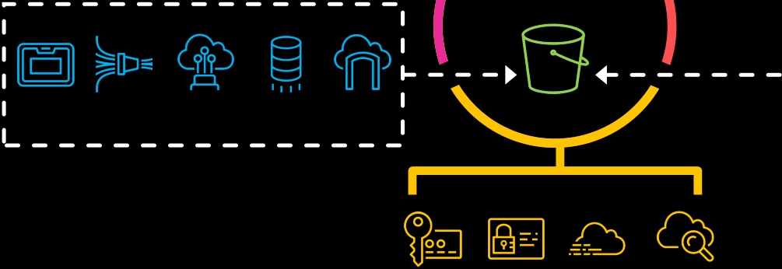

AWS의 데이터 레이크
Amazon Amazon Elasticsearch AWS
DynamoDB Service Glue
Catalog & Search
AWS Amazon Amazon
AppSync API Gateway Cognito
Access & User Interfaces
Central Storage
Scalable, secure, cost-
effective
Amazon
Athena
Amazon
EMR
AWS
Glue
Amazon
Redshift
Amazon
DynamoDB
AWS
Snowball
Amazon
Kinesis Data
Firehose
AWS Direct
Connect
AWS Database
Migration
Service
AWS Storage
Gateway
S3
Data Ingestion
Manage & Secure
AWS AWS
IAM CloudTrail
Amazon Amazon Amazon
Kinesis Elasticsearch Neptune
Service
Analytics & Serving
Amazon
QuickSight
Amazon
RDS
AWS
KMS
Amazon
CloudWatch
© 2019, Amazon Web Services, Inc. or its affiliates. All rights reserved.

Slide 78
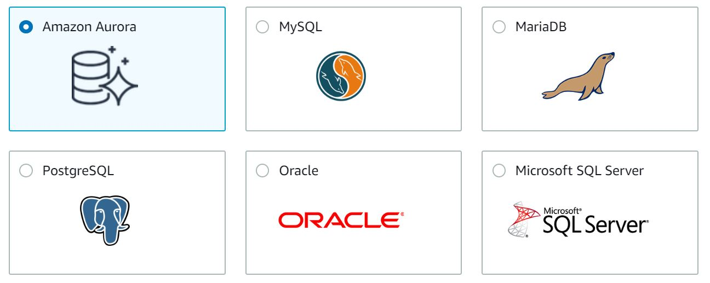
DB 엔진

Slide 79
DB 서버 접근
public access
security group
EC2 instance의 SG을 RDS database security group의 inbound 에 적용

Slide 80
RDS
RDS create,
public access
private access : only EC2 instance inside VPC
EC2 create, EC2 sg 를 RDS sg 의 inbound rule에 추가
EC2 – security group id : copy
RDS : Actions ➔ security group ➔ edit inbound rule
MYSQL/Aurora port 3306

Slide 81
EC2 에서 RDS 접근 - mysql
$sudo apt update
$sudo apt install mysql-client
$mysql -h /RDS instance endpoint -u admin -p
$mysql -h database-1.cour8cblgiau.ap-northeast-2.rds.amazonaws.com -u admin -p

Slide 82
Mysql cli
CREATE DATABASE mydatabase;
use mydatabase;
CREATE TABLE tb33 (
id INT(6) UNSIGNED AUTO_INCREMENT PRIMARY KEY,
username VARCHAR(30) NOT NULL,
password VARCHAR(30) NOT NULL,
email VARCHAR(50)
);
DESC tb33;

Slide 83
Mysql cli
INSERT INTO tb33 (username, password, email) VALUES ('johnsmith', 'password123', 'johnsmith@example.com’);
INSERT INTO tb33 (username, email, password) VALUES ("cwro", "cwro777@gmail.com", "mypassword");
INSERT INTO tb33 (username, email, password) VALUES (“cwro11”, “cwro77711@gmail.com”, “11mypassword”);
INSERT INTO tb33 (username, password, email) VALUES (‘Jack”, “password123”, “johnsmith@example.com”);
INSERT INTO tb22 (username, password, email) VALUES (“johnsmith”, “password123”, “johnsmith@gmail.com”);
INSERT INTO tb33 (username, email, password) VALUES (“mms", “mms777@gmail.com", “silla123");
SELECT * FROM tb33;

Slide 84
CREATE TABLE student (
id INT AUTO_INCREMENT PRIMARY KEY,
이름 VARCHAR(100) NOT NULL,
학생번호 VARCHAR(20) NOT NULL UNIQUE,
학과 VARCHAR(100) NOT NULL
);
DESC student;

Slide 85
INSERT INTO student (이름, 학생번호, 학과) VALUES ('kim1', '1234', '컴공’);
Select * from student;

Slide 86
mysql/mariadb
select user();
select version();
drop database company;
create database company;
show databases;
use company;
show tables;

Slide 87
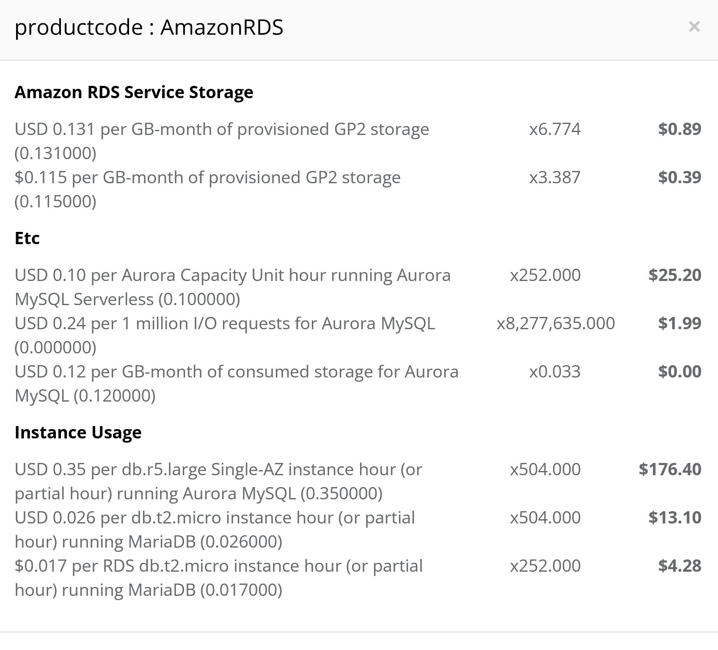

Slide 88
4
AWS Lambda
AWS 계정관리
Lectures
서버리스 lambda
lambda RestAPI
lambda DynamoDB
Hands-on
S3 –lambda-DynamDb
lambda-Python
cloudwatchS3
AWS 계정관리

Slide 89

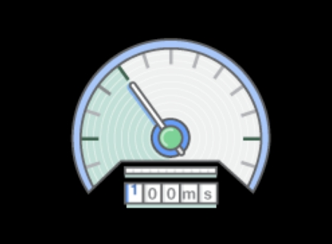
서버리스란?
• 서버를 생성하거나 관리할 필요가 없음
• 요청에 맞추어 확장 가능
• 사용한 만큼만 비용 지불
• 고가용성(HA) 및 재해 복구(DR) 내장
© 2019, Amazon Web Services, Inc. or its affiliates. All rights reserved.

Slide 90

© 2019, Amazon Web Services, Inc. or its affiliates. All rights reserved.

Slide 91


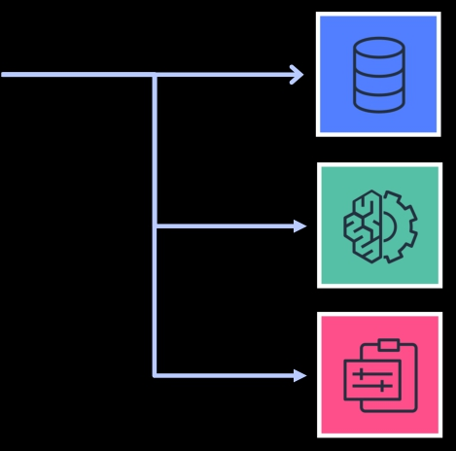

AWS Lambda
이벤트 소스
AWS Lambda Function
다양한 종류의 서비스
데이터 상태 변경
Node.js
Python
Java C# Go
Ruby
Runtime API
엔드포인트 요청
리소스 상태 변경
© 2019, Amazon Web Services, Inc. or its affiliates. All rights reserved.

Slide 92
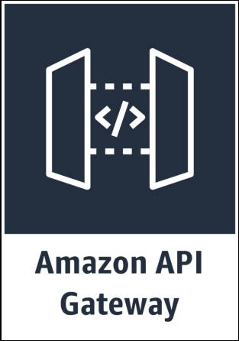
Amazon API Gateway
HTTP 요청을 받아 AWS Lambda의 이벤트 소스로 사용하도록 합니다. 또한 WebSocket을 지원하여, Stateful 한 요청을 Stateless한 백엔드 서비스로 라우팅할 수 있습니다.
• 자동적 확장
• 인증 지원
• API 요청 제한
• SSL 적용
© 2019, Amazon Web Services, Inc. or its affiliates. All rights reserved.

Slide 93

DynamoDB (w/Global Tables)
Amazon DynamoDB를 이용하여 서버리스 애플리케이션 데이터를 쉽게 저장할 수 있습니다.
• 99.999%의 SLA가 적용되는 NoSQL 데이터베이스
• 멀티 리전 및 멀티 마스터 테이블 지원
•
대규모 글로벌 애플리케이션을 지원 가능한 빠른 읽기 / 쓰기
성능
• 콘솔에서의 클릭 몇 번으로 쉽게 생성하는 글로벌 테이블
© 2019, Amazon Web Services, Inc. or its affiliates. All rights reserved.

Slide 94







Other AWS services
Amazon Cognito – 페더레이션 및 인증
Amazon Route 53 – 메트릭 기반 DNS 라우팅 및 헬스 체크 Amazon CloudFront – 컨텐트 배포 및 가속
AWS CloudFormation + SAM – 구성 관리 Amazon S3 buckets – 정적 웹 사이트 호스팅
AWS Identity and Access Management (IAM) – AWS 리소스 권한 관리 Amazon CloudWatch – 모니터링
© 2019, Amazon Web Services, Inc. or its affiliates. All rights reserved.

Slide 95








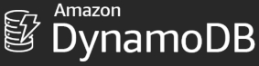
AWS Step Functions 새로운 서비스 통합
구축, 실행이 쉽고 안전한 완전 관리되는 자동화된 워크플로
마이크로서비스 배치 작업 분석 및 ML

Slide 96






























The Amazon ML stack:
A I SERVICES Vision Speech Language Chatbots Forecasting Recommendations
App 개발자용
R E K O G N I T I O N I M A G E
R E K O G N I T I O N V I D E O
B U I L D
T E X T R A C T
P O L L Y T R A N S C R I B E T R A N S L A T E
A M A Z O N
S A G E M A K E R
T R A I N
C O M P R E H E N D
L E X
F O R E C A S T
D E P L O Y
P E R S O N A L I Z E
ML SERVICES
ML 개발자 및
데이타 과학자용
Pre-built algorithms & notebooks
Data labeling (G R O U N D T R U T H )
Algorithms & models ( A W S M A R K E T P L A C E F O R M A C H I N E L E A R N I N G )
One-click model training & tuning Optimization (N E O ) Reinforcement learning
One-click deployment & hosting
F r a m e w o r k s I n t e r f a c e s I n f r a s t r u c t u r e
ML FRAMEWORKS &
INFRASTRUCTURE
ML 연구자 및
학계용
E C 2 P 3
& P 3 D N
E C 2 C 5
F P G A s
G R E E N G R A S S
E L A S T I C
I N F E R E N C E
I N F E R E N T I A
© 2019, Amazon Web Services, Inc. or its affiliates. All rights reserved.

Slide 97
AWS Lambda : Serverless function
API Gateway
REST API
SILLA UNIVERSITY

Slide 98
Download /chrome 웹 스토어
https://chrome.google.com/webstore/category/extensions?hl=ko
API tester
Postman = 단종
reslet ➔ talend
크롬 웹스토어
Talend API Tester로 일별 박스오피스 긁어오기
https://www.youtube.com/watch?v=Jz9_Qm3FR4w

Slide 99
Lambda
Virtual functions – no servers to manage
Limited by time –short executions
Run on-demand
Automated scaling

Slide 100
Lambda language support
Node.js
Python
Java
C# (.NET core)
C# / powershell
Ruby
Custom Runtime API

Slide 101
Benefits of AWS Lambda
• Easy Pricing:
• Pay per request and compute time
• Free tier of 1,000,000 AWS Lambda requests and 400,000 GBs of compute time
• Integrated with the whole AWS suite of services
• Integrated with many programming languages
• Easy monitoring through AWS CloudWatch
• Easy to get more resources per functions (up to 10GB of RAM!)
• Increasing RAM will also improve CPU and network!
© Stephane Maarek
NOT FOR DISTRIBUTION © Stephane Maarek www.datacumulus.com

Slide 102










AWS Lambda Integrations Main ones
API Gateway
CloudWatch Events
EventBridge
Kinesis
CloudWatch Logs
DynamoDB
SNS
S3
SQS
CloudFront
Cognito
NOT FOR DISTRIBUTION © Stephane Maarek www.datacumulus.com
© Stephane Maarek

Slide 103
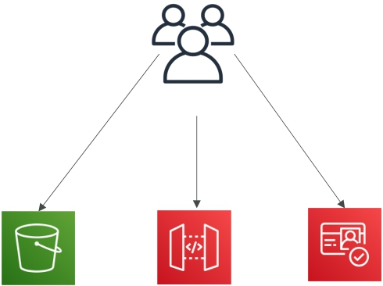


Lambda
Users
Login
Staticcontent
REST API
S3 bucket
API Gateway
Lambda
DynamoDB
Cognito

Slide 104






Lambda: Serverless thumbnail creation
push New thumbnail in S3
trigger
push
Image name Image size Creation date etc…
New image in S3
AWS Lambda Function
Creates a Thumbnail
Metadata in DynamoDB

Slide 105


Lambda: Serverless CRON job
CloudWatch Events
EventBridge
AWS Lambda Function
Perform a task

Slide 106
Lambda
Lambda url+ discover ➔ url + begin
https://ap-northeast-2.console.aws.amazon.com/lambda/home?region=ap-northeast-2#/discover
Hello world
Code, test, configuration, monitor
Configuration
- permission – Execution role – Cloudwatch logs
WEB REST API

Slide 107
AWS Lambda로 게시판 서버 API 만들기 ① - REST API 틀 잡기 [AWS Lambda 강좌]
https://www.youtube.com/watch?v=x0iyaENTxU0

Slide 108
API-Gateway
방법 1 : HttpMethod ANY
방법 2
1. create resource
2. create Methods – GET, POST,..
Method type: GET,
Integration type – lambda,
Lambda function : region, ARN lambda
Lambda proxy integration : on
3. deploy
API gateway ==> endpoint

Slide 109
API troubleshooting
1. problem
// 20230509112339
// https://gwq7zyfkci.execute-api.ap-northeast-2.amazonaws.com/depcof1
{
"message": "Missing Authentication Token"
}
2. sol) endpoint url 뒤에 resource 명 추가 url/coffee
https://gwq7zyfkci.execute-api.ap-northeast-2.amazonaws.com/depcof1/coffee
deploy: stage: default

Slide 110
AWS S3 - Lambda - dynamodb
IAM
S3
Lambda
dynamodb
SILLA UNIVERSITY

Slide 111
JSON- S3 - Lambda - dynamodb
data.json
upload
s
Python
Node.js

Slide 112
IAM
1. create policy
Service = choose service
Fullaccess =S3, cloudwatchlog, lambda, dynamodb
Actions =all
Resources = all
Table ADD ARN
2. create Role
Lambda -> select policy

Slide 113
S3 – lambda - dynamodb
event trigger
S3 : upload data.json
Lambda function with IAM
Design : event trigger on S3 -> bucket 지정
Function code : handler : get S3 bucket and put dynamodb Table
Basic settings – IAM role
IAM
Role – policy : access & permission S3 bucket, dynamodb, cloudwatch
Cloudwatch log for debugging

Slide 114
Function
Configuration
Designer, function code, basic settings
Permissions
Execution role – Role name
Resource summary

Slide 115
data.json
s3 getobject python == Boto3 Docs
print(str(event)) – cloudwatch logstream ➔ copy Records
Online JSON viewer
http://jsonviewer.stack.hu/
Sublime text

Slide 116
Trouble shoot -lambda
AWS Configuration is ambiguously defined. Cannot have overlapping suffixes in two rules if the prefixes are overlapping for the same event type.
Error 해결방법
https://jsikim1.tistory.com/183

Slide 117
Add one more S3 trigger
S3
instead of add trigger, use bucket properties
create bucket
Properties ➔ create event notification
➔Event type : all object create events
➔ Destination type : Lambda function
➔ Destination : Lambda function name

Slide 118
Hands-on II
Web app using AWS Lambda ,S3, API-gateway and DynamoDB
https://github.com/kemanedonfack/aws-serverless-web-application
https://numericaideas.com/blog/aws-serverless-web-application/
AWS Lambda & AWS DynamoDB & AWS S3 | Writing CSV Data do dynamoDB from AWS S3 Using AWS Lambda
https://www.youtube.com/watch?v=59edv-9vqDA

Slide 119
Web app using AWS Lambda ,S3, API-gateway and DynamoDB
Trouble shoot
Add policy
IAM ➔ users ➔ find user ➔ permission policies ➔ add permission
Enable CORS
API gateway ➔ resource 선택 ➔ enable CORS

Slide 120
IAM users 생성 -AWS CLI
make user_list.json (by mk_userlist)
create users : cruser.sh (chmod +x cruser.sh ./cruser.sh)
add polish (by addpolicy.sh)
set password (setpw.sh)
delete users (by deluser.sh)

Slide 121
IAM users 생성 -AWS CLI
Accountid :
create users : cruser.sh (chmod +x cruser.sh ./cruser.sh)
add polish (by addpolicy.sh)
set password (setpw.sh)
delete users (by deluser.sh)

Slide 122
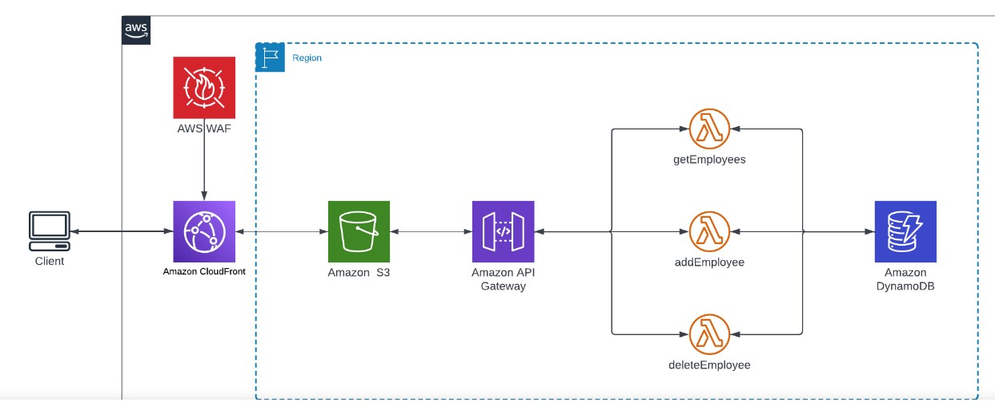
Webapp using AWS S3, API-gateway, Lambda, DynamoDB

Slide 123

AWS DynamoDB
SILLA UNIVERSITY

Slide 124
Amazon DynamoDB
• Fully managed, highly available with replication across multiple AZs
• NoSQL database - not a relational database - with transaction support
• Scales to massive workloads, distributed database
• Integrated with IAM for security, authorization and administration
• Low cost and auto-scaling capabilities
• No maintenance or patching, always available
• Standard & Infrequent Access (IA) Table Class

Slide 125
Amazon DynamoDB
• DynamoDB is made of Tables
• Each table has a Primary Key (must be decided at creation time)
• Each table can have an infinite number of items (= rows)
• Each item has attributes (can be added over time – can be null)
• Maximum size of an item is 400KB
• Data types supported are:
• Scalar Types – String, Number, Binary, Boolean, Null
• Document Types – List, Map
• Set Types – String Set, Number Set, Binary Set
• rapidly evolve schemas

Slide 126
AWS Kinesis
Kinesis Data streams
Kinesis Data Analytics
Kinesis Data Firehose
SILLA UNIVERSITY

Slide 127
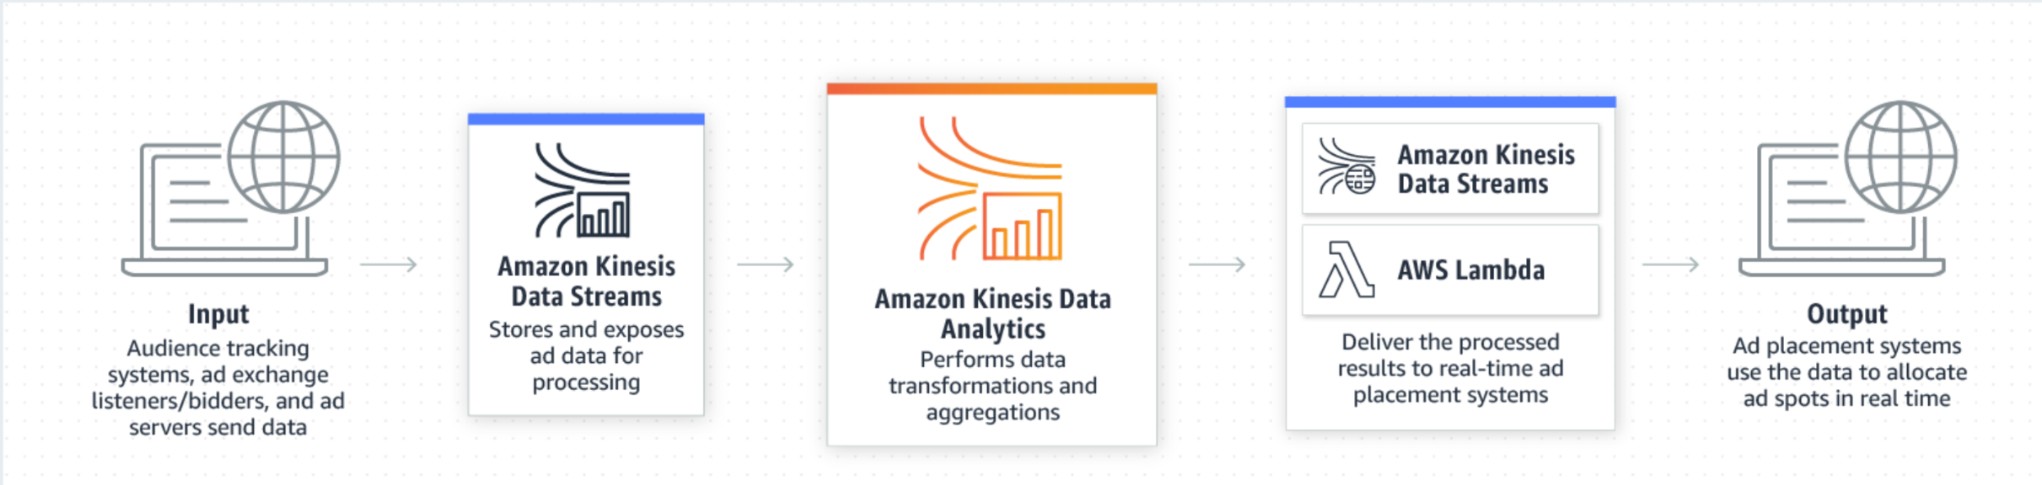

Slide 128
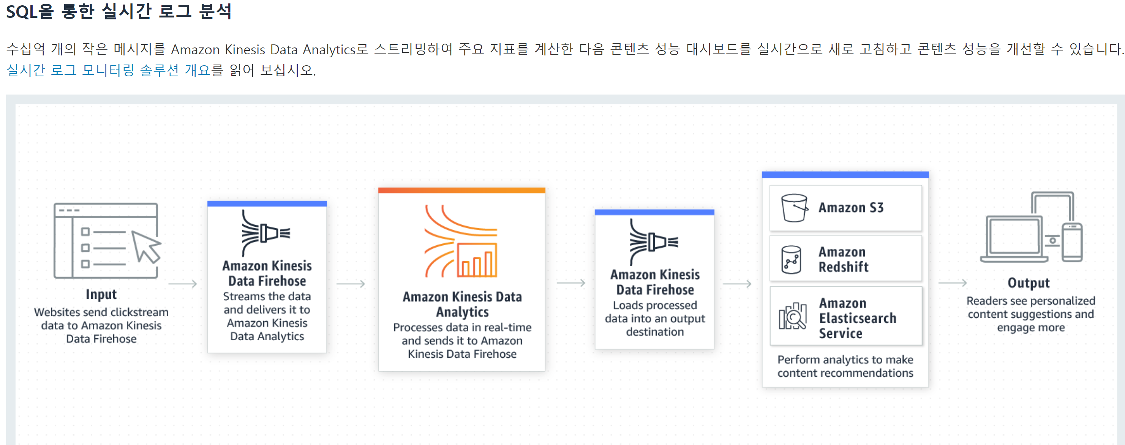

Slide 129
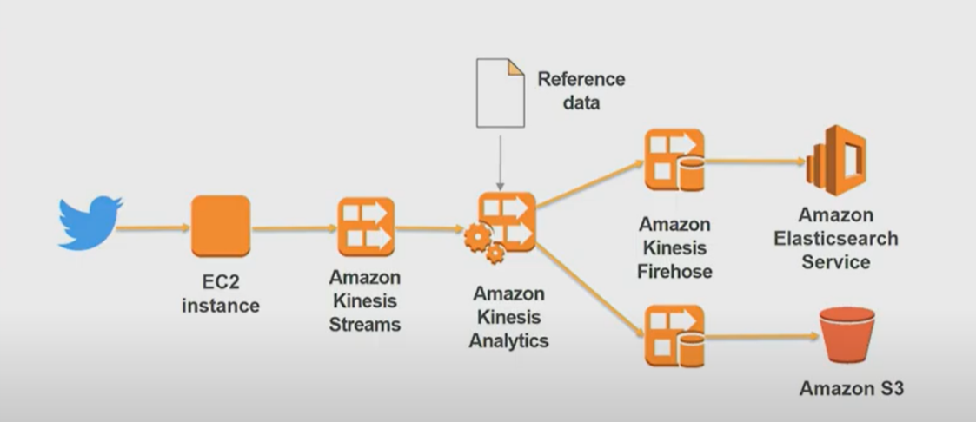
Kinesis Architecture

Slide 130
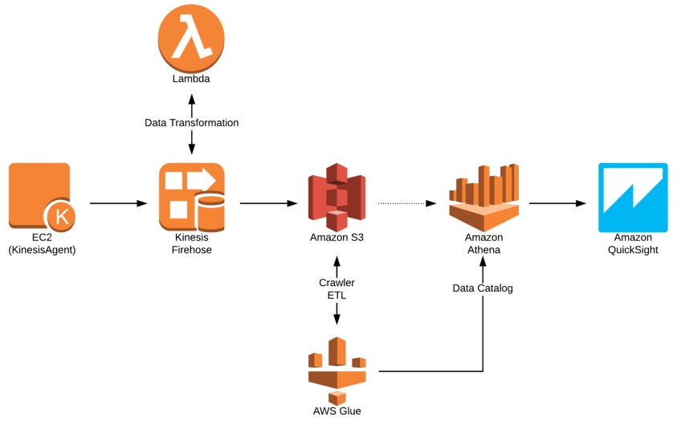
Kinesis Architecture

Slide 131
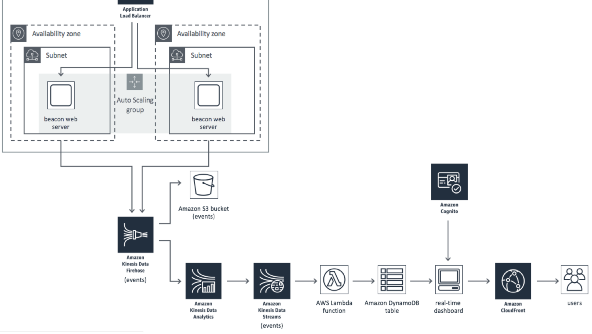

Slide 132
Python3 in EC2 (old version)
Download FileZilla Client for Windows (64bit)
filezilla-project.org › download
In Ubuntu 18.04,
pip intstall 대신 python-pip 설치하고 pip3 install 명령 사용
python 3 설치되 있음
sudo apt-get update
sudo apt-get install python3-pip python3-venv
pip3 install bs4
#pip upgrade
#sudo –h pip3 install –-upgrade pip

Slide 133
Python3 in EC2 : boto is not available on Python 3.12
sudo apt-get update
sudo apt-get install python3-pip python3-venv
#sudo pip install virtualenv
sudo apt install python3-virtualenv
virtualenv venv
source venv/bin/activate
(venv) $ pip3 install -r requirements.txt
(venv) $ python3 limit_Webdata_generator_retailer.py
(venv) $ pip3 install boto
(venv) $ pip3 freeze > requirements.txt
deactivate

Slide 134
Kinesis Data Streams and Lambda Triggers Python
https://www.youtube.com/watch?v=6wot9Z93vAY
https://github.com/soumilshah1995/learn-kinesis-labs

Slide 135
Python3 in EC2 : boto3
sudo apt-get update
sudo apt-get install python3-pip
#sudo pip install virtualenv
sudo apt install python3-virtualenv
virtualenv venv
source venv/bin/activate
(venv) $ pip3 install -r requirements.txt
(venv) $ python3 datastreams.py
(venv) $ pip3 install boto
(venv) $ pip3 freeze > requirements.txt
deactivate

Slide 136
Add on
pip list
#$ python3 -m virtualenv venv
#$ virtualenv venv --python=python3
pip upgrade
#sudo –h pip3 install –-upgrade pip

Slide 137
Stream analytics
SQL applications ➔ source –real-time analytics-destination
Create SQL application ➔ source-configure ➔ discover schema
source –real-time analytics-destination : destination
➔ (add destination) ➔ Firehose
Firehose –destination setting – edit
S3 bucket –Buffer hints
Buffer size, buffer interval: 300sec ➔ 60 sec

Slide 138
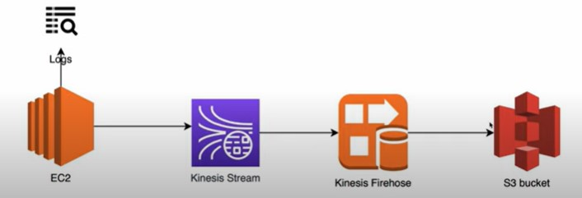
Kinesis-Firehose-S3

Slide 139
Kinesis-Firehose-S3
Amazon data Firehose
Firehose streams – create Firehose stream
Source : Kinesis
Destination : S3
IAM Firehose stream = add permission
Add Administrator access

Slide 140
Project
AWS Athena를 이용한 서버리스 보고서 만들기. 소개 | by Siheon Kim | Mar, 2023 | Hbsmith
https://blog.hbsmith.io/aws-athena%EB%A5%BC-%EC%9D%B4%EC%9A%A9%ED%95%9C-%EC%84%9C%EB%B2%84%EB%A6%AC%EC%8A%A4-%EB%B3%B4%EA%B3%A0%EC%84%9C-%EB%A7%8C%EB%93%A4%EA%B8%B0-a2b2983f1c64

Slide 141
Trouble shooting
cors 오류 트러블슈팅에 gpt의 hallucination이 발생했다 proxy 통합 lambda는 백엔드에서 해결해야한다.
https://docs.aws.amazon.com/ko_kr/apigateway/latest/developerguide/how-to-cors.html
REST API 리소스에 대한 CORS 활성화 - Amazon API Gateway

Slide 142
핫스팟으로 연결된 상태에서 EC2 SSH 접속방법
https://bony-spell-7d4.notion.site/EC2-SSH-6dc3c98af1674cfdb08a1765672c02ba

Slide 143
